Slide 1


WEEK 13
SPRINT 4
PL6
REQ

Slide 2


about us.

Slide 3
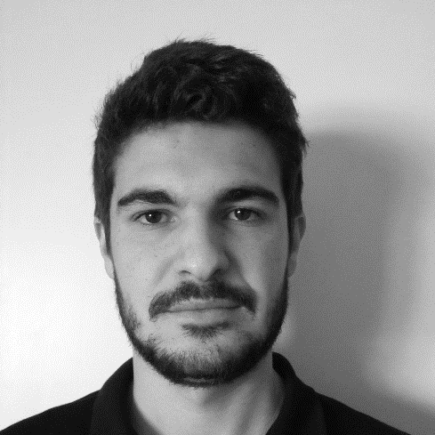
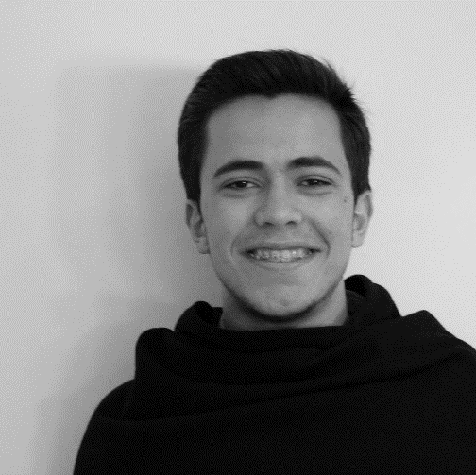
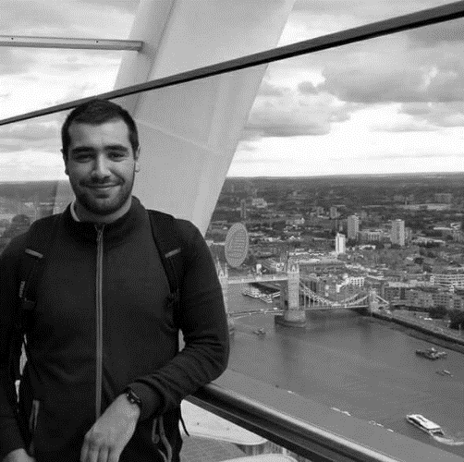

req.
Emanuel
Marco
Paulo
Nuno

Slide 4
tasks.
 | TASK #1 | TASK #2 | TASK #3 | TASK #4 | TASK #5 | TASK #6
TASK | Update Mockups | Update Requirements Document | Weekly presentation | Inspection Meeting | Inspection Minute | Update Quality Manual
OWNER | Nuno | Emanuel, Paulo, Marco | Marco | Emanuel, Paulo | Emanuel | Marco
GOAL EFFORT | 2 H | 2 H 00 | 1 H | 1 H 00 | 0 H 30 | 1 H
EFFECTIVE EFFORT | 2 H 30 | 2 H 30 | 0 H 30 | 1 H 00 | 0 H 45 | 1 H
STATUS | On course | On course | COMPLETED | COMPLETED | COMPLETED | COMPLETED

Slide 5
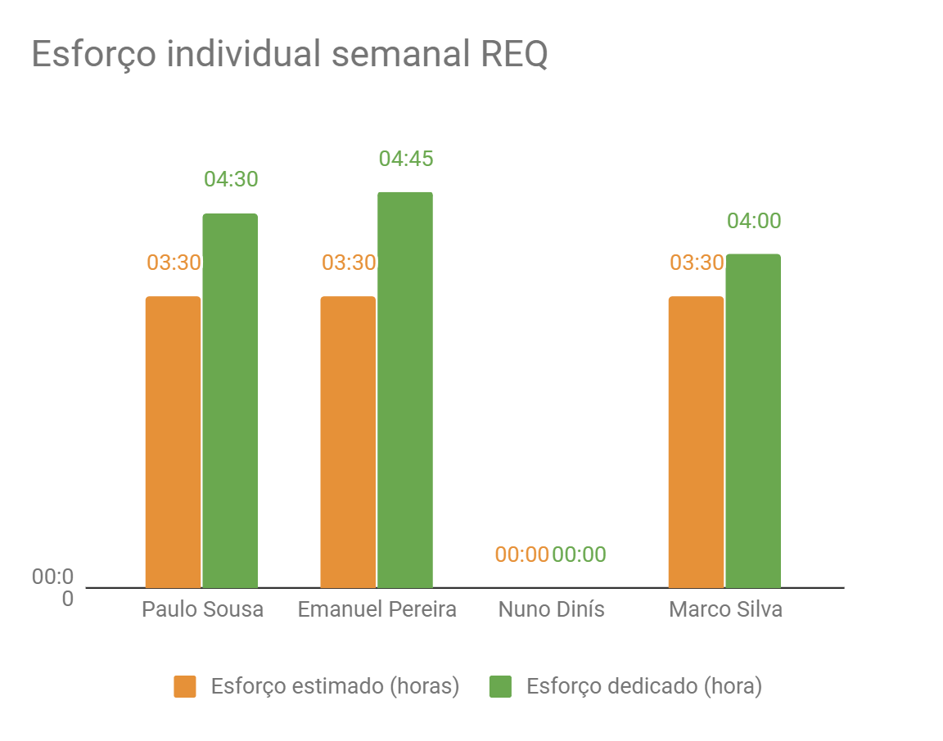
Effort.

Slide 6
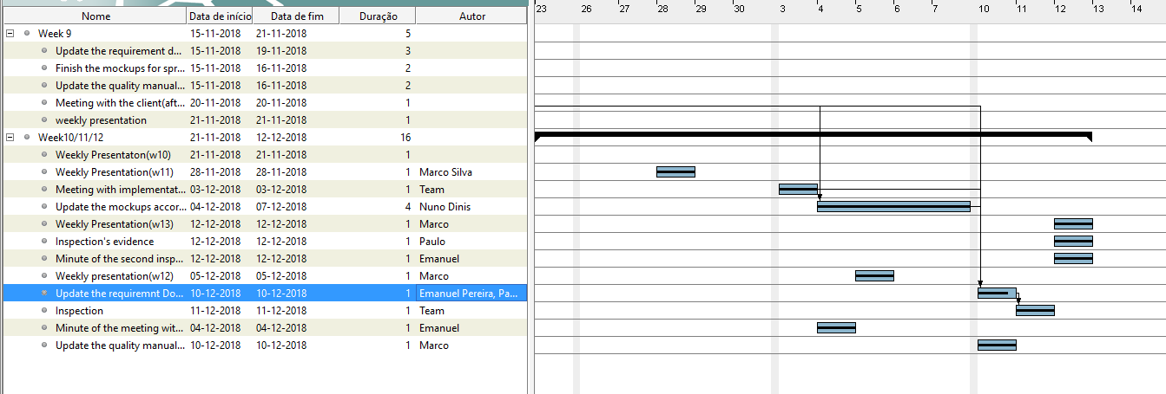
Gant.

